Slide 1
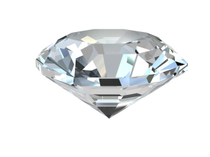
An Introduction to
the Nitrogen-Vacancy Center in Diamond
Lily Childress
McGill University
V
N
Diamond Sensing Workshop
August 5, 2015
Takamatsu, Japan
Notes:
Good morning. (The disembodied voice you are listening to right now is me, Lily Childress, and )As is clearly evident, I’m very sorry to say that I cannot be with you in person for the Diamond Sensing Workshop, but the organizers have been kind enough to allow me to prepare a virtual presentation. So I would like to thank them both for the invitation to speak, and the generosity to accommodate a last-minute travel issue.
And so, it’s a great pleasure to be able to, hopefully, over the next hour and a half, give you my perspective on the ins and outs of one of the systems you’ll be hearing a lot about over the next few days, namely the nitrogen-vacancy center in diamond.

Slide 2
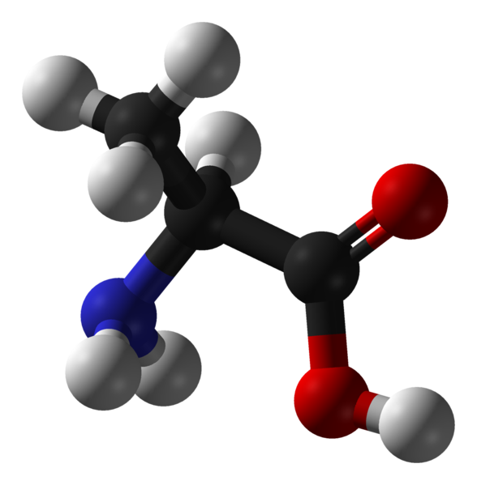
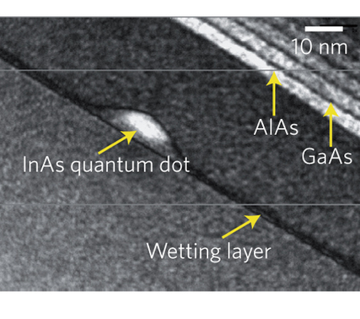
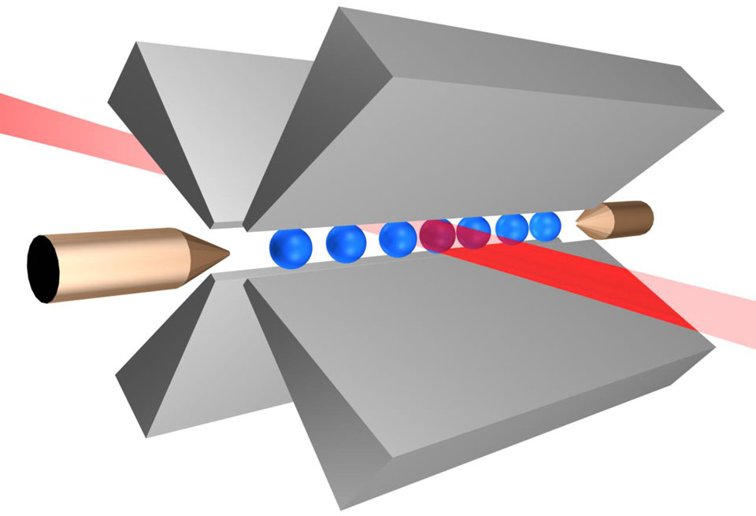
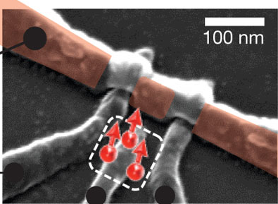
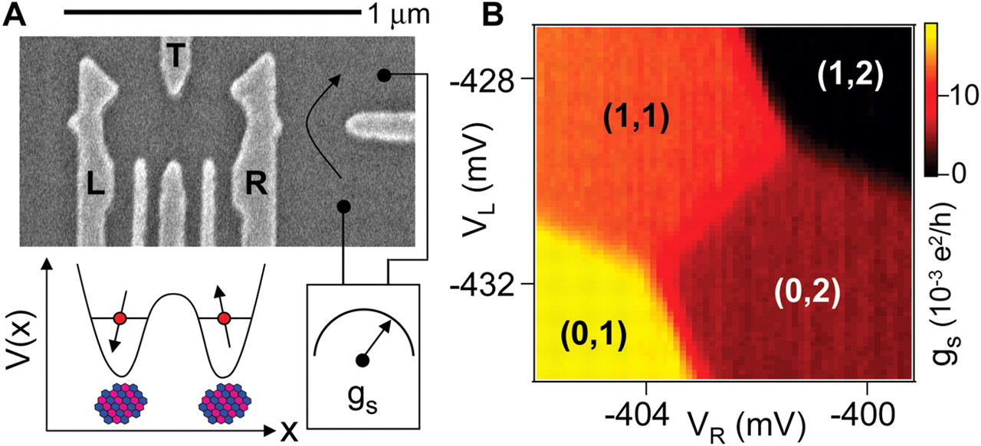
A bit of context and motivation…
Solid state spins
Spins associated with single atoms, ions,
& molecules
Integrated electronic and optical devices on-chip
Tunable properties, fast control
Warburton Nature 2013
Innsbruck
Morello et al. Nature 2010
Long spin coherence times
Narrow optical transitions with good selection rules
nm-scale confinement
Petta
et al. Science 2005
The NV center in diamond:
Optical access to individual electronic and nuclear spins (even at room temperature)
Notes:
Interest in the NV center grew, over the last decade, our of a large-scale effort to understand and control individual spins. Spins confined to quantum dots or bound to electrically gated donors can have highly attractive device characteristics, with gate-tunable properties and fast control. While the NV center – a crystalline defect in diamond -- certainly shares some of their properties, in many ways such deep defects can more closely resemble spin systems in atoms or molecules. Like atoms and ions, the ground state spin degrees of freedom of the NV center can be accessed optically – as of yet, they can’t be probed in transport, and much of this talk will be aimed at giving you some understanding of how the structure of the NV center allows us to prepare and measure its electronic and nuclear spin states using optical excitation and detection.

Slide 3
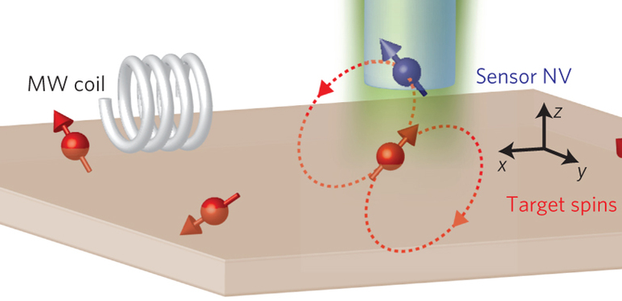
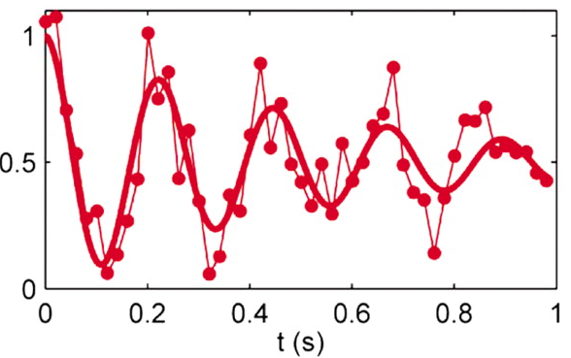
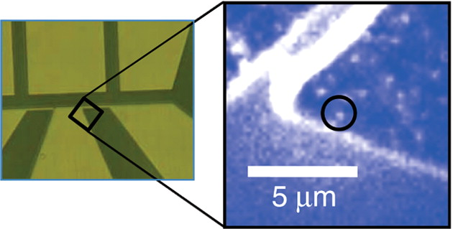
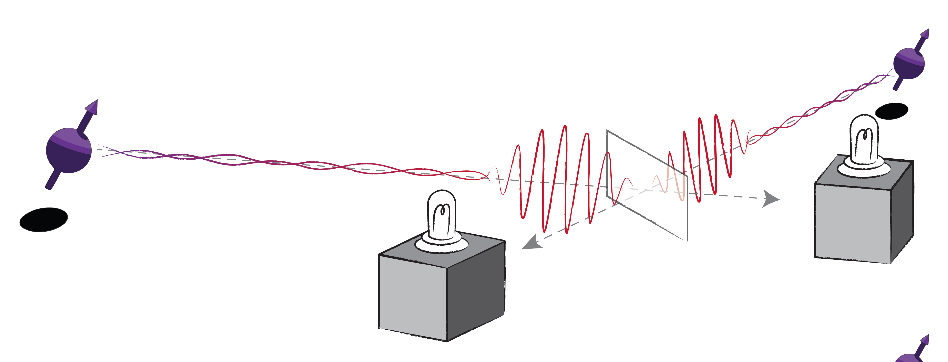
A bit of context and motivation…
The NV center in diamond:
Optical access to individual electronic and nuclear spins
Maurer et al Nature 2012
Quantum memory ~ 1 second at room temperature
Grinolds et al Nature Physics 2013
A magnetic sensor capable of detecting a single electronic spin
Fuchs et al Science 2009
Entanglement between spins 3m apart
Fast one- and two-qubit gates (ns – μs) with on-chip waveguides
And quite a bit more!
Notes:
And this optical access to individual spins in diamond has let do some remarkable results. A single nuclear spin has been used as a quantum memory with a coherence time of more than a second at room temperature – and this in a system where fast spin control – ns for electronic spins, microseconds for nuclei -- can be achieved with on-chip waveguides. The long coherence time and small spatial extent of the electronic spin of the NV has led to development of magnetic sensors capable of detecting a single electronic spin – or about 100 protons. And spins of NV centers on either side of a laboratory have been entangled by using the spin-dependent optical transitions as a mediator.
And this is just a small taste of the many extraordinary experiments that have emerged over the last few years.

Slide 4
Why the NV center in diamond?
There are a many optically active, paramagnetic crystalline defects!
SiV⁻ in diamond
T_{v2} in SiC
Divacancies in SiC
Rogers et al. PRL 113, 263602 (2014)
Christle et al. Nature
Mat. 14, 160 (2015)
Widmann et al. Nature Mat 14, 164 (2015)
…and many others!
The host: Wide bandgap, low spin-orbit interactions, spin-free nuclear isotopes
The diamond NV center:
Long spin coherence times and coherent resonant optical transitions
By far the most studied…
Notes:
A natural question is why the NV center in diamond has been so successful. After all, there are a huge variety of crystalline defects, many of which also have spin and coherent optical transitions to play with. And indeed, the community is starting to explore many of these alternatives in greater detail, including other defects in diamond such as the SiV, as well as defect systems in alternate hosts like silicon carbide. Of course, not all defects and not all hosts are equal. For example, ideal host crystals would have a wide bandgap, low spin-orbit interactions, and spin-free nuclear isotopes. And the NV center has some particularly nice properties, as we will see later this hour. But in some regards, its special status arises because it is by far the most studied – it is the second most common defect in diamond. And so, even for those interested in other defect systems, there is much to be learned from the wealth of knowledge the community has developed around the nitrogen vacancy center in diamond.

Slide 5
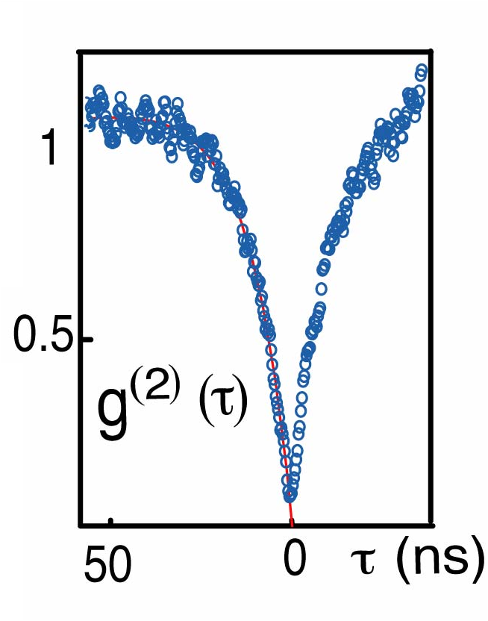
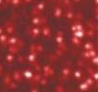
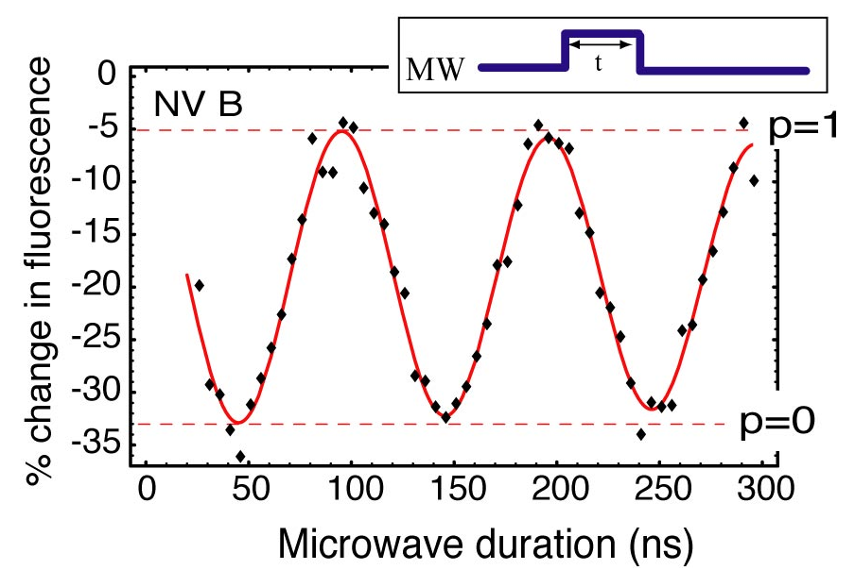
A brief picture
Ground state electronic spin triplet
Photon anti-bunching
e⁻
V
e⁻
e⁻
e⁻
e⁻
e⁻
Microwave
spin manipulation
Excited state
S = 1
N
5 μm
Optical transitions: single-defect isolation,
Even at room temperature
preparation & detection of the electronic spin
Higher initial fluorescence from m_{s}= 0
Optical polarization into m_{s}= 0
Spin S = 1 electronic ground state
m_{s} = ±1
Mediated by spin-dependent intersystem crossing to
metastable singlets (S = 0)
m_{s} = 0
Stuttgart, Harvard, UCSB, Canberra
Notes:
So let me begin by giving you a brief, simple overview of the NV center. The NV center is formed by a substitutional N next to a missing carbon (vacancy) in the diamond lattice, and in its negatively charged state (which is the state most people study), six electrons occupy the dangling bonds around the vacancy. In the ground state of this system, these electrons have a net spin S = 1 quantized along the N to V axis – and this is the degree of freedom most commonly studied. The defect also has an excited state; since the excited state is well within the diamond bandgap, it can be excited nonresonantly with e.g. a green laser pointer. Such nonresonant excitation changes both the electronic orbital state and excites vibrations. The vibrations quickly decay, and the defect fluoresces in the red wavelengths. These optical transitions can be used to isolate individual defects in a confocal microscope. This image is taken by scanning a green laser….. These white spots correspond to individual defects, which can be verified by examining the photon statistics in emission, and verifying that two photons are never emitted at the same time.
More interestingly, the optical transitions also give access to the spin degree of freedom. The spin state ms = 0 fluoresces more strongly than ms = +/-1, and after some microseconds the spin polarizes into ms = 0 – the mechanism involves a spin-dependent relaxation through metastable singlet states. Combined with a microwave line to drive spin resonance, these optical processes enable observation of the coherent oscillations of a single spin with relative ease.

Slide 6
A brief picture
Ground state electronic spin triplet
Coherent interactions with proximal nuclear spins
V
Microwave
spin manipulation
Excited state
S = 1
N
5 μm
Optical transitions: single-defect isolation,
Even at room temperature
preparation & detection of the electronic spin
and the nuclear spins with which it interacts
< 10K
Spin S = 1 electronic ground state
Atomic-like optical transitions at cryogenic temperatures enable higher preparation fidelity and readout sensitivity
m_{s} = ±1
m_{s} = 0
Today: A more detailed understanding of the NV
An overview of current research areas
Stuttgart, Harvard, UCSB, Canberra
Notes:
Nonresonant excitation is not the only mechanism for optically accessing the NV spin. At cryogenic temperatures, the NV center exhibits sharp, atomic-like optical transitions which afford a much more sensitive mechanism for spin preparation and readout.
Another feature of the NV center is that its electronic spin is not alone. In some samples, it will interact coherently with one or more impurity nuclear spins in the surrounding lattice, and the optical mechanisms to access the electronic spin can be readily extended to such nuclear spins, affording a few-spin system akin to an NMR molecule in a crystalline host.
So this is the basic, brief picture, of the NV center, and today I’d like to fill in the gaps, and show you some of the details that often get swept under the rug. And, as time allows, I’ll also give you my perspective on the major research thrusts in this field.

Slide 7
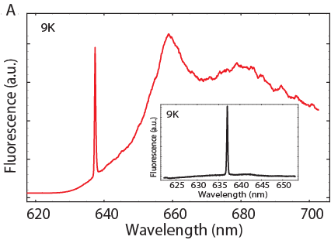
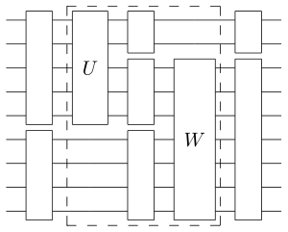
Outline
Introduction
  Context and motivation
  A brief overview of NV physics
V
The structure of the NV center
  Physical and electronic structure, optical transitions
  Spin-dependent optical processes at cryogenic and ambient temperatures
N
Spin physics with NV centers
  Hyperfine interactions
  Coherence properties
Applications and research highlights
  Quantum information science
  Metrology
Outlook
  New directions and outstanding challenges
Notes:
So, yes, the requisite outline! You’ve already heard my introduction, so

Slide 8
Outline
Introduction
  Context and motivation
  A brief overview of NV physics
V
The structure of the NV center
  Physical and electronic structure, optical transitions
  Spin-dependent optical processes at cryogenic and ambient temperatures
N
Spin physics with NV centers
  Hyperfine interactions
  Coherence properties
Applications and research highlights
  Quantum information science
  Metrology
Outlook
  New directions and outstanding challenges
Notes:
let’s get started with a much more detailed picture of the structure of this defect.

Slide 9
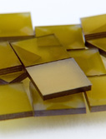
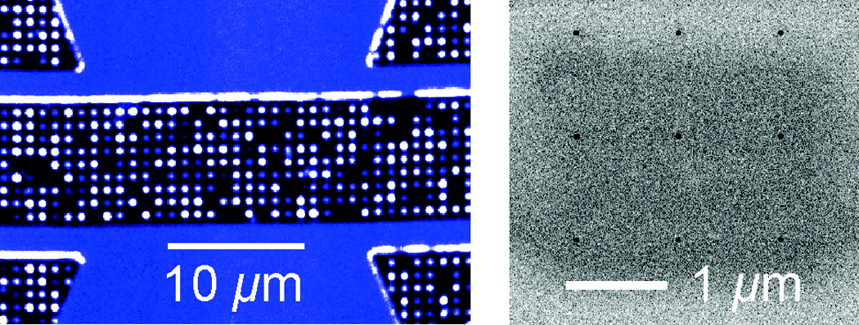
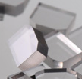
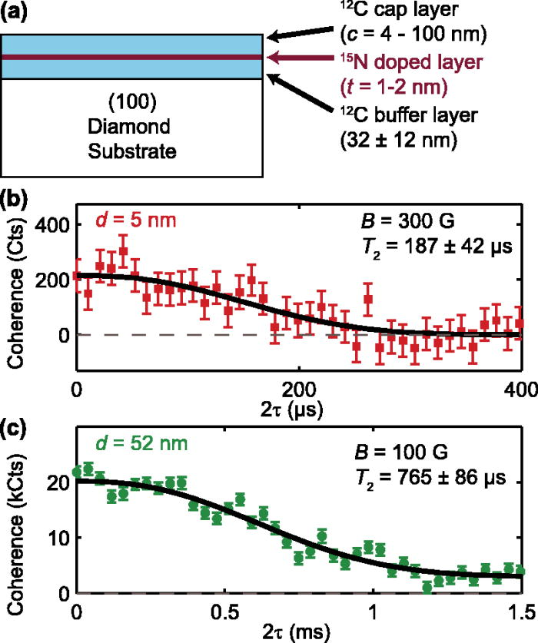
Physical structure: NV center formation
Natural (or as-grown)
most stable optical transitions and longest spin coherence times
Near-surface spins are rare
Irradiation and annealing
V
~ MeV electrons create vacancies
~ 800C vacancies become mobile, can combine with N impurities
N
Element 6
Very high NV density possible
Type Ib diamond:
~ 100ppm [N]
Toyli et al Nanolett. 2010
Implantation and annealing
few keV (and up) N implantation
Can locate NVs to ~ few 10s of nm with masked implantation
Delta-doping during CVD growth
Near-surface NVs with highly controllable depth
Element 6
Type IIa diamond:
~ 1ppm [N]
Electronic grade:
< 5ppb [N]
Nanodiamond (can be irradiated)
Often poor optical and spin properties
Stuttgart, Berkeley, UCSB, HP, Melbourne, Harvard, and others
Notes:
A natural place to start is with sample growth – how are NV centers created? Many experiments use NV centers that occur in natural or synthetic diamond without any additional processing. For many diamonds, the problem is that there are too many NV centers, and you can’t isolate individual ones. The density and properties of such defects depend strongly on the type of crystal and in particular on the density of other defects. Type 1b diamond, commonly grown in high temperature high pressure processes, typically has a very high density of nitrogen – and also quite a few NVs. Type Iia diamond, low nitrogen concentration, can be grown with CVD processes, and it is now possible to purchase CVD diamonds with extraordinarily low concentrations of nitrogen – and also, unfortunately, extraordinarily low concentrations of NVs! But as-grown NVs in this electronic grade material are currently the state of the art in terms of the stability of their optical transitions and spin coherence times.
NV centers can also be added to diamond via a variety of processes. One way to convert nitrogen into NV centers is to irradiate the diamond with something (electrons or protons or…) to produce vacancies. Upon annealing, the vacancies become mobile and can recombine to form NV centers. Alternately, one can implant nitrogen into ultrapure substrates in a similar type of process. Implantation also allows spatial control over the location of the defects, as the position of the nitrogen atoms move little during annealing. By implanting low-energy nitrogen through nanoscale apertures, it is possible to create NV centers with a few dozen nanometer accuracy.
A newer technique, which is highly promising for creating stable NVs, is to introduce nitrogen in a defined layer during the CVD growth process. While it can only control the depth of the defects, it can yield near-surface NVs with near-bulk properties.
Finally, many experiments have been performed with nanodiamond. While there have been some recent advances in nanofabricating high quality nanodiamond, most nanodiamond powders are highly strained and full of defects and produce NVs with poor optical and spin properties.

Slide 10
Physical structure: Charge states
Commonly distinguished by differing fluorescence spectra:
NV⁰ 5 electrons
NV⁻ 6 electrons
575 nm transition
V
Aslam et al. NJP 15, 013064 (2013)
637 nm transition
N
Control over charge state:
Weber et al. 2010 PNAS
Add something here about NV0? Why we don’t use that one?
[N] donors
Applied voltage/current
Surface termination
Grotz et al. 2013 Nat. Comm.
NV⁰
NV⁻
Doi et al. PRX 4, 011057 (2014)
NV⁻ ground state predicted 2.8 eV above valence band maximum
Hauf et al. 2011 PRB
Optical excitation
Notes:
So now that we’ve somehow managed to find or create a nitrogen next to a missing carbon in diamond, we need to consider the charge states of this physical structure. If you consider the number of electrons that should occupy these dangling bonds in charge neutrality, you would arrive at the conclusion that two electrons come from the nitrogen donor, and one each from the dangling bonds of the neighboring carbon atoms. However, an additional electron (most likely coming from another distant nitrogen donor) can also bind to the defect, and in fact it is this negatively charged version of the NV center which we typically study. Ab initio calculations have predicted that the neutral NV is the equilbrium state when the Fermi level likes low in the diamond bandgap, while the NV- ground state is predicted about 2.8 eV above the valence band maximum. These charge states can be distinguished by different fluorescence spectra, as the NV0 has slightly higher energy optical transitions than the NV-. The charge state can be controlled in a few different ways, including controlling the Fermi level in the diamond (typically with nitrogen density). Surface termination can play an important role for near-surface defects – for example, hydrogen termination can result in a hole gas at the surface which leads to neutral or even positively charged NV centers in the vicinity of the surface, while oxygen or fluorine termination favors the negatively charged version. Application of gate voltage can change the charging level, and optical excitation can also be used dynamically switch between the NV- and NV0 states.
The NV0 is a spin-1/2 system that suffers from fast spin dephasing in the ground state, and nearly all of the attention has been focused on the NV- system, so I’ll focus in on the electronic structure of the six electron state

Slide 11
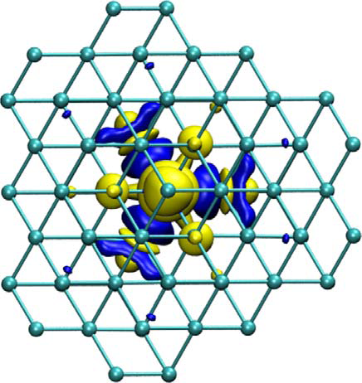
The electronic structure of the NV⁻ center
e⁻
What are the energy levels for 6 electrons occupying the dangling bonds of the NV defect?
e⁻
e⁻
e⁻
e⁻
e⁻
V
Approaches:
Ab initio numeric calculation
Symmetry properties and qualitative effects of interactions
N
N
Gali, PRB 80 241204R 2009
V
Spherical symmetry => possible orbitals s, p, d, f
Correspond to irreducible representations of the group of 3D rotations
C_{3v} symmetry
A₁, A₂, E – irreducible representations of the group of C_{3v} symmetries
Coulomb interaction => Hund’s rules
Notes:
There are a few different approaches to considering the electronic structure of a defect. Ab initio calculations can give very accurate predictions of both ground and excited state properties, and have been very successful in explaining experimental observations. A complementary approach is to consider only the symmetry properties of the defect, along with the expected types of interactions, in combination with experimentally determined parameters, to create a phenomenological model. Today I’ll try to show you how this latter approach gives a qualitative picture of the electronic structure of the defect.
Even if you’ve never studied point defects before, you’ve likely used a similar approach in your quantum mechanics or atomic physics classes. When you classified atomic orbitals with labels s, p, d, f, you were actually using the symmetry properties of the system – that is, the group of rotations in three dimensional space; and the possible energy levels correspond to the irrreducible representations of the group of rotations. When you considered the spin filling of atoms according to Hund’s rules, you were using the same kind of qualitative consideration of interactions that we’ll use today.
In the case of the NV center, the symmetry group that describes the system is called C3V. It corresponds to the group of symmetries of the pyramid formed by the nitrogen atom and the three nearest-neighbor carbon atoms. It has six elements: the identity – doing nothing -- rotations by 2Pi/3, 4Pi/3 and the three reflections – like this one -- that do not change the shape of this pyramid. And as a result, we will label the energy levels of the NV center by the designations of the irreducible representations of this group of symmetries – A1, A2, and E

Slide 12
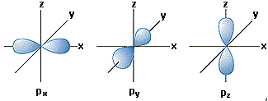
Why does symmetry matter?
A system exhibits a symmetry
⬄
Symmetry transformations don’t affect the Hamiltonian
S_{R} commutes with the Hamiltonian
Operations S_{R} form a group:
“group of the Schrodinger equation”
How do eigenstates of H transform under these symmetry operations?
=>
Applying a symmetry operation yields another degenerate eigenstate
i.e. some linear combination of the degenerate eigenstates
Notes:
Since this is a tutorial, I can take the time to say a few words about where this comes from. Why should the symmetry of a system affect its electronic structure?
When we say that a system exhibits a symmetry, what we mean is that the Hamiltonian that describes the system doesn’t change if you change the coordinate axes by any of the symmetry operations, i.e. symmetry operations commute with the Hamiltonian.
So let’s consider what one of these symmetry operators – for example a rotation of coordinate axes – will do to one of the eigenstates (electronic orbitals) of the Hamiltonian. Since the symmetry operator commutes with the Hamiltonian, applying a symmetry operator to an eigenstate yields another eigenstate with the same energy.
In particular, if you have some set of degenerate eigenstates, any symmetry operator will only transform between them. To make this more concrete, you can consider for example the p orbitals of the hydrogen atom, where any rotation in 3-space of, e.g., the px orbital, will yield a linear combination of px, py, and pz.

Slide 13
Why does symmetry matter?
Symmetry operations transform between degenerate eigenstates
A system exhibits a symmetry
⬄
Γ is also an irreducible representation (IR)
An l_{n}-dimensional matrix representation of the group of symmetry operations
An energy level can be classified by its irreducible representation Γ
Energy level E_{n} with degeneracy l_{n}
l_{n} – dimensional IR of the group of symmetries
⬄
Example: “3d” states of hydrogen form a 5-fold degenerate level with states that transform under rotations according to a 5-dimensional matrix representation of the group SO3.
Knowing the structure of the group of symmetries of a system yields
  degeneracy of the levels
  transformation properties of the “basis functions” (states)
  selection rules for e.g. dipole transitions
Notes:
Since the symmetry operators only transform between degenerate eigenstates (within a given energy level), there is a mapping from each symmetry operator to a matrix that describes its operation on the eigenstates. Of course these matrices multiply together the same way that the symmetry operators do, so they form a matrix representation of the group of symmetries. And for the group theory experts, this is also an irreducible representation because the symmetry operators will mix all of the degenerate eigenstates, regardless of which basis you chose to write them in.
The upshot of this is that every energy level can be classified by which set of Gamma matrices – which irreducible representation of the group of symmetries – its degenerate eigenstates transform as. An energy level with degeneracy l must correspond to some set of l-dimensional matrices which form an irreducible representation of the group.
As an example, the 3d states of hydrogen form a 5-fold degenerate level with states (or basis functions) that transform under rotations according to a 5-dimensional matrix representation of the group of rotations in 3D.
As a consequence, if you understand the structure of the group of symmetries – _{including} what its irreducible representations can be – you can do things like predict the possible degeneracy of energy levels, deduce the transformation properties of the degenerate eigenstates (which in group theoretic language are refered to as basis functions) and even derive selection rules for transitions.

Slide 14
Irreducible representations of C_{3v}
A₁
A₂
E
Dimensionality = degeneracy
1
1
2
The identity representation – the basis function transforms into itself under all symmetry operations.
The {1, -1} representation – the basis function picks up a minus sign under reflections.
Basis functions transform into each other the way that the vectors x and y transform into each other under the C_{3v} symmetry operations
like s
like triplet m_{s} = 0
like p_{x} and p_{y}
Symmetrized LCAO orbitals for the NV center:
Two a₁ orbitals:
These orbitals are not exact – but their symmetry is!
N
a₁, a₁’ are linear combinations of these two
Two e orbitals:
N
e_{y}
V
N
C
N
V
C
e_{x}
C
C
C
V
C
C
V
C
C
C
C
C
Notes:
In the case of the NV center, there are three irreducible representations of C3v. They are labelled by A1, A2, and E. A1 and A2 are both one-dimensional representations (that is, the symmetry operations just act as scalars, and there is only one basis function). For A1, the identity representation, there is only one basis function (it’s a nondegenerate energy level), which transforms into itself under all symmetry operations – this is very much like the way that a spherically symmetric state like an s state would behave. A2 is also a 1D representation, with only one basis state, but the rotations map onto the identity while the basis function picks up a minus sign under reflections. The only state I could easily come up with which behaves this way is the triplet state ms = 0. Since C3V is a finite group, there is a finite number of irreducible representations, and the final one is called E. It’s a two-dimensional representation, so there are two basis states, which transform under the symmetry operations much like the vectors X and Y would behave.
To get a picture of how this is used in the NV center, it is instructive to consider the symmetrized orbitals that could be constructed from the dangling bonds of the NV center – these correspond to basis functions for the symmetry operations. Considering the original sp3 type orbitals, you can construct two basis states with a1 symmetry, and two states that form the basis functions for an e level. In these pictures, yellow and blue have opposite sign. Of course the actual electronic orbitals don’t look exactly like this, but they do have their symmetry.
You can develop a qualitative picture of the NV structure by considering how electrons fill these symmetrized orbitals. From a consideration of coulomb interactions with the ions, one finds that the a1 states are lowest in energy, with a mixture of the two orbitals as I’m pictured being low enough in energy to lie within the valence band. In this simple single-particle picture, the second a1 state and the E level are both in the bandgap of diamond.

Slide 15
Electronic configurations of the NV center
Single-electron picture (LCAO orbitals)
Conduction band
e_{x}
e_{y}
Adding in spin:
Need to consider exchange!
Antisymmetric orbital configuration minimizes Coulomb energy
=> favors spin triplet
a₁
Valence band
a₁’
Spin triplets
Spin singlets
A₁
A₂
E_{x}
E_{y}
E₁
E₂
First excited state configuration:
a₁’²a₁e³
Symmetrized LCAO orbitals for the NV center:
¹E’
Two a₁ orbitals:
(electrons)
These orbitals are not exact – but their symmetry is!
(holes)
a₁e
a₁, a₁’ are linear combinations of these two
N
Two e orbitals:
N
¹A₁
e_{y}
V
N
C
N
V
C
e_{x}
¹E
C
C
Ground state configuration:
a₁‘²a₁²e²
C
V
E
C
C
V
(electrons)
C
C
C
A₁
Maze et al. 2011 NJP
Doherty et al. 2011 NJP
e²
(holes)
C
C
Notes:
The ground state for six electrons should thus completely fill the two a1 levels, with two electrons occupying the e orbitals. This ground state configuration can be written like this…or, more simply, in terms of the two holes that occupy the e states. The next energy configuration must then promote an electron from the higher a1 level to an e level – or equivalently, move a hole down to the a1 level.
But of course we are really interested in looking at the spin of the defect, and to do that we need to consider exchange effects. Within the ground state, the coulomb energy is minimized when the orbital state is antisymmetric, so the overall ground state must be formed by an antisymmetric combination of the ex and ey orbitals and a spin triplet. Here, I’m giving you the hole representation of the state, since it is considerably simpler to write! This strong effect of coulomb interactions is sometimes illustrated in level diagrams by separating the majority and minority spin states.
There are also three spin singlet states within this ground state electronic configuration, which will have higher energy than the triplet state – two form an E level, and the third is a singlet A1 level.
The excited state configuration also contributes an E level, formed by symmetric combinations of the two hole states. The final set of states I’ll show you comes from the spin triplet states within the excited state electronic configuration. Now before I put them up, let me warn you. There are three spin states to consider, and two orbital states (since the hole can occupy either e orbital) for a total of six states. Appropriately symmetrizing these states within C3V involves considering both how orbital and spin degrees of freedom transform, and it is a little bit…involved. In the end, the spin and orbit states get entangled for some of the levels, and there are six combined spin and orbit states. Here, the orbital components are given by letters and if you want to know the details I’ll refer you to these papers from a couple of years ago.

Slide 16
Electronic structure of the NV center
Spin triplets
Spin singlets
A₁
A₂
E_{x}
E_{y}
E₁
E₂
¹E’
¹A₁
¹E
E
A₁
Notes:
So what should we make of these electronic levels? Well so far, we only know their degeneracy and the approximate ordering from Coulomb interactions. To go beyond that, let’s focus in on the spin triplet states, which form the ground state and the optically excited state of the NV center.

Slide 17
Electronic structure of the NV center
Energy levels determined by
the Coulomb interaction
spin-orbit interaction
spin-spin interaction
Yields a complete model in terms of empirically measured parameters
Spin triplets
A₂
A₁, A₂
A₁
A₂
E_{x}
E_{y}
E₁
E₂
A₁
E_{x}, E_{y}
E_{x}, E_{y}
E₁, E₂
A tiny little bit mixed
E₁, E₂
Symmetry properties also determine selection rules for transitions
E
m_{s}= ±1
A₁
m_{s}=0
m_{s}= 0
Notes:
In particular, one thing I’d like you to take away from this is that there are ms = 0 states (again, quantized along the N to V axis) in both the ground state and the excited state, whereas the ms = +/-1 levels get entangled with the orbital state in the excited configuration.
To say more about the ordering of these energy levels, we need to consider not just the Coulomb interaction (which sets the splitting between the ground and excited electronic configurations), but also the spin-orbit interaction (which affects the orbitally degenerate excited state) and the spin-spin interaction (which affects both the ground and excited states – this is the magnetic interaction between the spins of the electrons in the NV). The details of this calculation must be left for further reading, but it is worth noting that the spin-spin interaction is responsible for splitting the energy of the ms = 0 and ms = +/-1 states, and also very slightly hybridizes the E levels, which leads to a small degree of mixing between the ms = 0 and ms = +/-1 states.
Finally, symmetry properties also determine the selection rules for transitions between the electronic states of the NV center

Slide 18
Electronic structure of the NV center
Spin Triplets
Spin Singlets
¹E
A₂
λ_{z} S_{z} L_{z}
The spin-orbit interaction can mix singlets and triplets with the same symmetry
A₁
E_{x}, E_{y}
λ_{xy} (S₊ L₋+S₋ L₊)
E₁, E₂
fast
fast
¹A₁
σ₊
σ₋
¹E
X
Y
E
m_{s}= ±1
A₁
m_{s}= 0
Mechanism for spin-selective intersystem crossings
Notes:
I’ve re-drawn the levels here, with singlets and triplets horizontally separated, and the ground and excited state electronic configurations separated by the blue rectangles. Optical transitions couple different electronic configurations without affecting the spin, so that transitions between the ms = 0 ground and excited states are allowed (with linear polarization), while transitions between the remaining ms = +/-1 states are also allowed with circularly polarized polarization selection rules. We’ll see that these optical transitions can be readily probed at cryogenic temperatures, and occur at energies near 637nm.
While optical transitions cannot change the spin from triplet to singlet, the spin-orbit interaction (which contains terms involving single electron spin flips) can. Because the spin-orbit interaction is scalar, it can only mix states of the same symmetry, leading to intersystem crossings primarily out of the ms = +/-1 excited states and into the ms = 0 ground state. Within the singlets, optical transitions are also allowed, and in fact the partially allowed transition between A1 and E1 singlets has been observed at 1042nm.
This level structure is complicated, but hopefully you can see here how spin-selective intersystem crossings can arise – this plays a key role in the nonresonant optical properties of the NV center.

Slide 19
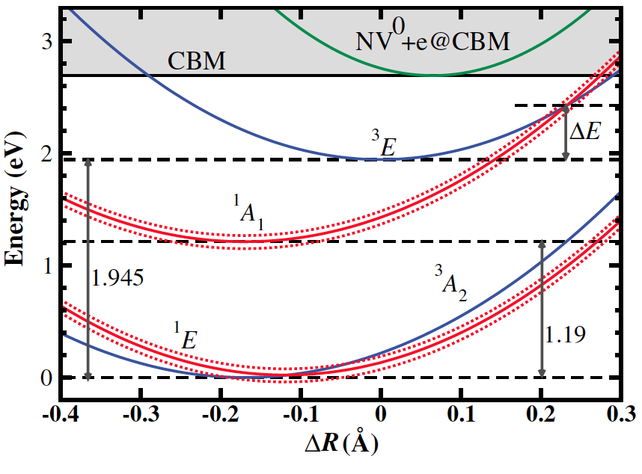
Vibronic structure of the NV center
“Phonon sidebands” in both absorption and emission
excited state
S = 1
e.s.
SiV⁻ : 80% of emission in ZPL
Energy
g.s.
ZPL
Not all defects have such strong phonon sidebands
Dominant vibronic modes ~70, 140 meV
ground state
S = 1
m_{s} = ±1
Muller et al. Nat. Comm. 2014
m_{s} = 0
Atomic displacement
N
Different equilibrium positions in the ground and excited states (ab initio calculations)
V
A more detailed understanding is starting to emerge…
local vibronic modes
dynamic Jahn-Teller in e.s.
vibronic states play a role in ISC
Goldman et al. PRL 114, 145502 (2015)
C
C
ZPL
PSB
Add something here about SiV?
C
Ma et al. 2010 PRB
Gali et al. 2011 NJP
Zhang et al. 2011 PRB
Abtew et al. 2011 PRL
Toyli et al. 2012 PRX
Notes:
So, thinking back to my introductory slides, hopefully you now have a more detailed understanding of what precisely these red and black lines mean. But if you recall, there’s one more part to that drawing that I haven’t yet discussed: the coupling to local phonons or vibronic modes.
One way to understand this coupling to phonons is to consider what happens when you excite the NV center from the ground to excited electronic configuration. Since the orbital state of the electronic charges changes, so too does the equilibrium position of the ions surrounding the NV defect. A simple picture of the role that phonons play in optical excitation can be obtained from considering the energy of the ground and excited states as a function of atomic displacement, interpolating between their equilibrum positions. Since they have different equilibrium positions, the mimima in energy occur at different configuration coordinates, and the harmonic dependence of energy on atomic displacement leads to quasi-local quantized vibrations. To a good approximation, optical transitions affect primarily the electrons and not the nuclei, so optical excitation out of the ground vibronic state will likely overlap strongly with higher vibronic states in the excited state. The vibrations quickly decay, and the defect emits out of the lowest vibronic state of the excited state, most commonly ending up in a high vibronic level of the ground state. This type of effect leads to strong phonon sidebands in both absorption and emission. In contrast, the direct electronic transitions are only driven within the so-called zero phonon line, which results from optical transitions coupling the ground vibronic states of each electronic configuration, with a matrix element proportional to the overlap between the tails of the ground and excited state zero point motion.
These interactions with phonons thus are responsible for the structure of the fluorescence spectrum of the NV center, which is characterized by a sharp zero phonon line at 637nm, accounting for about 3% of the fluorescence, and a broad phonon sideband that extends out to about 800nm.
This is only the simplest picture of vibronic coupling, and I should emphasize that a more detailed understanding is starting to emerge, including the structure of local vibronic modes, the role that Jahn-Teller effects play in the excited state, and the effect of vibronic states on intersystem crossings – I would refer you to some of these papers.

Slide 20
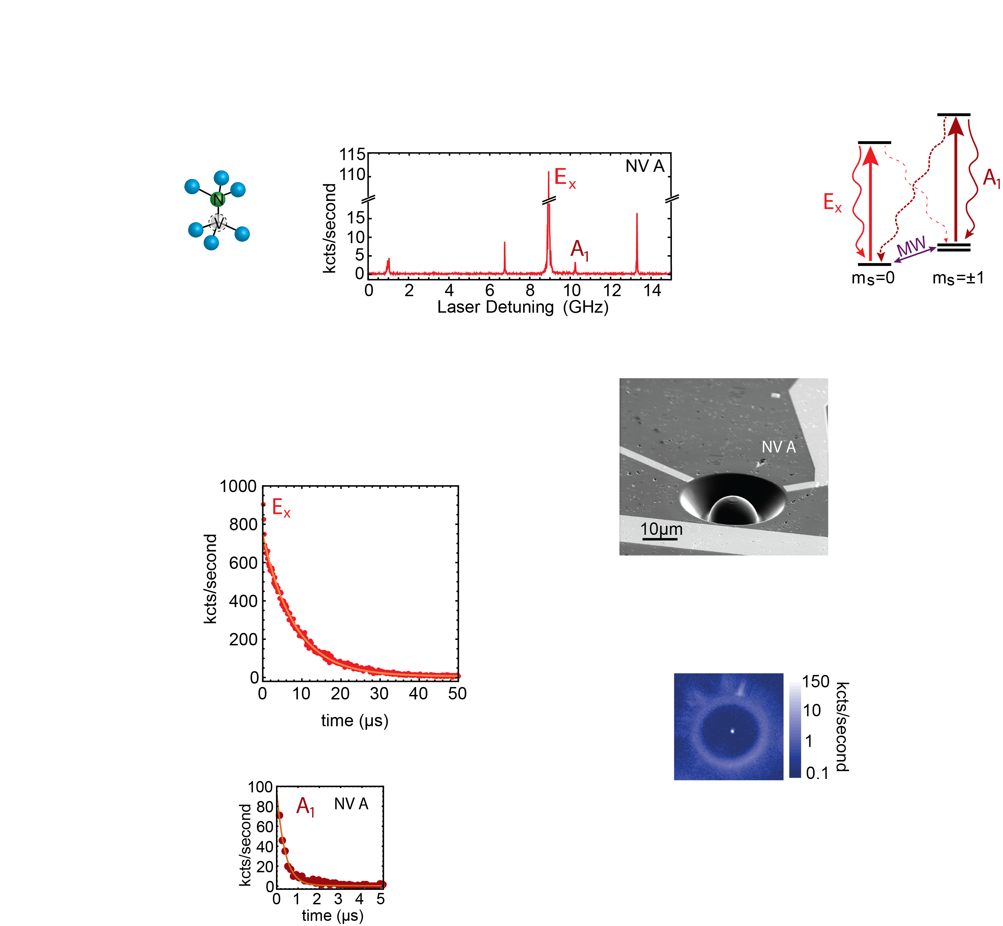
Resonant optical transitions at low temperatures
excited state
S = 1
Batalov et al.
2008 PRL
Confocal geometry to isolate single defects
ground state
S = 1
Nearly lifetime-limited optical Rabi oscillations
m_{s} = ±1
m_{s} = 0
Robledo et al. 2010 PRL
“PLE:”
Excite
Nearly lifetime-limited linewidths (12 ns)
(Only in select electronic-grade samples)
Detect
E_{x}
Spin-selective transitions
(MW required to see all these lines)
A₂
E_{1,} E₂
E_{y}
A₁
Local strain strongly affects the excited state
These spectra look different from NV to NV
Notes:
So now that we have a fairly complete picture of the electronic structure, I’d like to spend a bit of time describing the direct (zero phonon line) optical transitions, which I’ll sometimes refer to as “resonant” optical transitions. The features of these transitions can only be discerned at low temperatures, about 10K or below, and they are commonly probed by exciting resonantly with a 637nm laser on the ZPL while detecting the total fluorescence – this is called a photoluminescence excitation or PLE experiment, and it can be performed in a confocal geometry to only examine a single defect center. As you sweep a laser across the ZPL of a single defect, what you observe are a series of sharp resonances. These resonances correspond to transitions between individual states within the ground and excited electronic configurations, and they can be very sharp, with linewidths approaching the lifetime limit in select electronic-grade samples. The coherence of the optical transitions can be directly demonstrated by following the time evolution of the states, and observing Optical rabi oscillations, which can decay at nearly lifetime-limited rates.
These individual transitions are also spin-selective. Here I’ve labeled the the transitions by the symmetry of the excited state they drive, and for example you can see that the Ex transition is only excited out of the ms = 0 state.
However, you’ll also notice that it looks like I lied to you. The Ex and Ey states that I told you were degenerate are very clearly split here by a couple of GHz. And the reason is that this NV center does not have perfect C3v symmetry. Local strain in the diamond can break the symmetry and strongly affect the excited state properties, and indeed these spectra will look different for each NV depending on its local strain.

Slide 21
Strain effects at low temperatures
excited state
S = 1
Batalov et al. 2009 PRL
High transverse strain:
A₂
Two S=1 orbital branches
Linearly polarized emission, spin conserving in the limit of high strain
ground state
S = 1
A₁
m_{s} = ±1
E_{x,y}
m_{s} = 0
E_{1,2}
Zero strain:
C_{3v} symmetry
Axial strain shifts all the energy levels together
Significant mixing between spin states in lower branch
Electric fields have the same effect as strain
Tamarat et al. 2008 NJP
Notes:
In particular, the story I told you for C3V symmetry only rarely applies. Strain transverse to the NV axis breaks this symmetry, and can shift and even mix the excited states. What you see here are experimental data for resonant transitions as a function of strain, illustrating that the nominally degenerate states at zero strain rapidly shift apart. Moreover, in the lower branch level anticrossings can strongly mix the spin states. Finally, in the limit of high strain, the electronic states look like two orbital states each with spin S = 1, split by the strain.
I should mention that the strain along the NV axis of course doesn’t affect the symmetry, and just shifts the overall energy.
Intriguingly, electric fields can have the same effect as strain, making it possible to control some of these properties in situ.

Slide 22
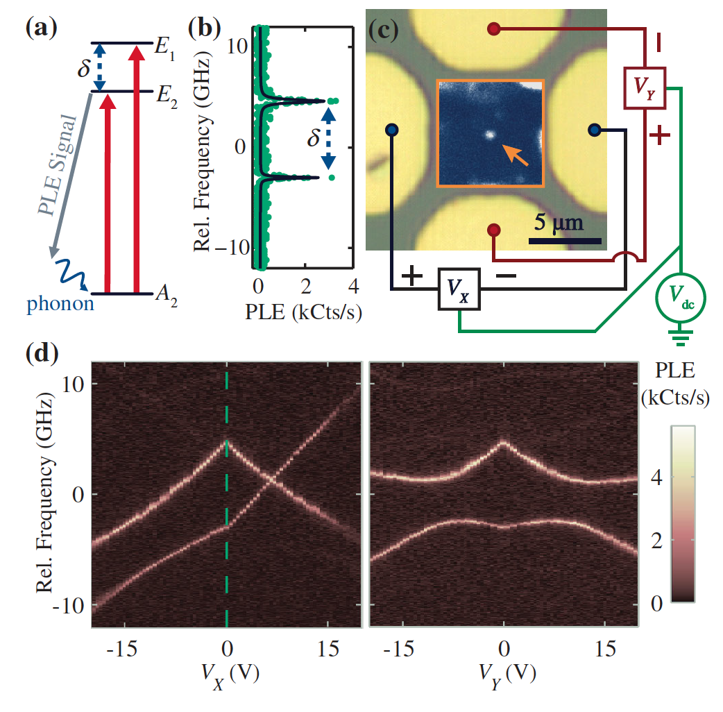
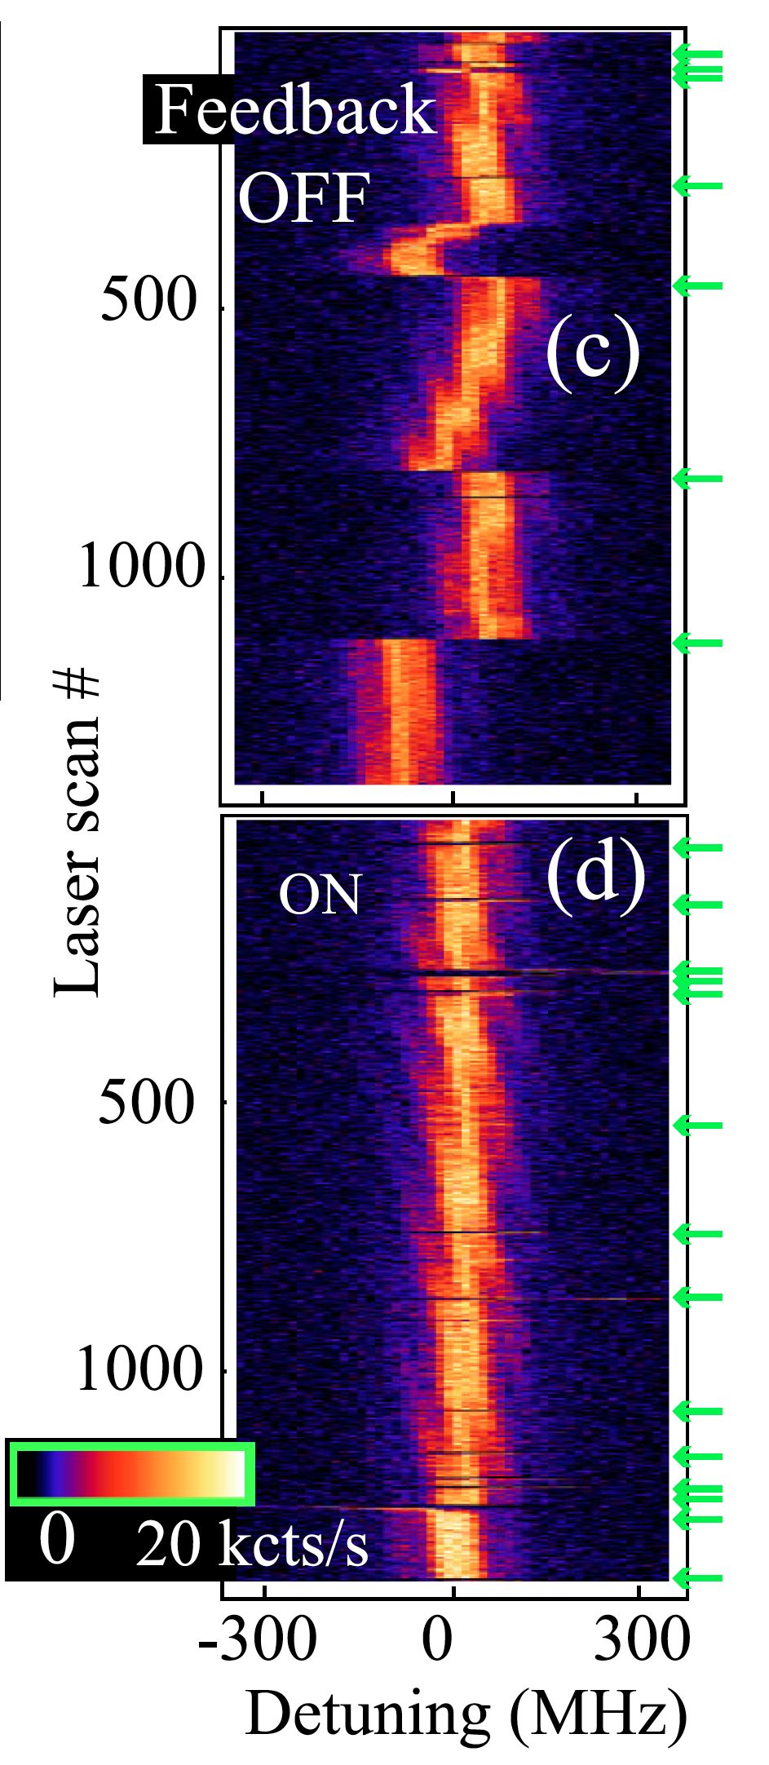
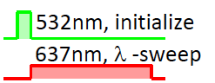
Resonant optical transitions: Features and Challenges
Electric field tunability
Ionization
E_{x}
CB
CB
Bassett et al. 2011 PRL
NV⁻
E_{y}
NV⁰
Robledo et al. 2010 PRL
VB
VB
See also Tamarat et al. 2006 PRL
Can even tune to “zero strain” symmetry regime
See Beha et al. 2012 PRL, Aslam et al. 2013 NJP
Electric field sensitivity => spectral diffusion
Can use voltage feedback
Fluctuating local electric fields lead to spectral diffusion
Or repump on the NV⁰ ZPL
532nm
Or repump until resonant
Laser
scan #
500
1000
Particularly from 532nm “repump” pulses
575nm
Acosta
et al.
2012 PRL
Robledo et al. 2010 PRL
Pfaff et al. 2013 Nat Phys
-300 0 300
Detuning (MHz)
See Wolters
et al. PRL 2013
Siyushev et al. 2013 PRL
Notes:
Indeed, I would note this as one of the Features of the NV resonant optical transitions. By fabricating electrodes on the sample surface and applying fairly moderate voltages, the optical transitions can be tuned over many GHz – as much as 300 GHz has been demonstrated. It’s even possible to apply electric fields to compensate for transverse strain, tuning into the “zero strain” regime.
Unfortunately, if a system has electric field tunabilty, it also has electric field sensitivity. As a local electric fields fluctuate, the frequency of a given optical transition can diffuse. This data shows the resonance as a function of time on the y axis, and you’ll notice particularly big jumps in the frequency at the locations of these little green arrows. What’s happening there is that a pulse of green 532nm light is applied before the spectrum is taken. This leads to fast changes in the local electric field as nearby charge traps ionize.
So why should we worry about spectral diffusion under green illumination? Well those green pulses serve a purpose. If you just apply resonant red excitation to an NV center, its fluorescence bleaches in a matter of milliseconds because the defect is ionizing into the neutral charge state. A schematic picture is that the negatively charged NV is excited by the red light, and from the excited state another red photon can ionize it, leaving the system in the ground state of the neutral NV, which is not affected by 637nm light. By appying a pulse of green light, you can excite the NV0 and then excite an electron out of the valence band, returning the system to the NV- state. So this combination of ionization and electric field sensitivity is one of the challenges of working with NV centers. Fortunately, there are a few ways to overcome it. One is to find a sample which has very few charge traps, and exhibits very little spectral diffusion. Another approach is to use electric fields to feed back and stabilize the transition frequency. Alternately, one can repump on the NV0 ZPL, which can be done at low powers (since it is resonant) and thus induces less spectral diffusion. Finally, you can check, repumping the system repetitively until it happens to land at the resonance frequency desired.

Slide 23
Using resonant optical transitions to access the NV spin
Optical pumping vs cycling transitions
Dispersive properties
Lambda level configurations
A₁ transition efficiently optically pumps into m_{s}= 0
>99% fidelity
E_{x} and E_{y} can be nearly cycling transitions (low strain, low T)
100s of optical cycles
Fluorescence detection of the spin state with >95% fidelity
See Robledo et al. 2011 Nature, Pfaff et al. 2013 Nat. Phys.
excited state
S = 1
Many photons
No photons
ground state
S = 1
m_{s} = ±1
m_{s} = 0
Notes:
Bearing in mind the challenges and features of these optical transitions, I’d like to finally turn to how they are used to access the NV spin at low temperatures.
One useful tool is optical pumping. By driving the system on just one of the spin dependent transitions (for example A1), you can pump the system into the spin state that isn’t excited by the laser light on microsecond timescales and with extremely high fidelity – much better than 99%. For optical pumping, it’s best to use transitions with a high spin flip probability, like A1, which couples strongly into the singlets.
In contrast, the ms = 0 state has very nearly cycling transitions. Excitation into the Ex and Ey states is almost completely spin conserving, and you can drive hundreds of optical cycles without flipping the spin. As a result, these transitions can be used to detect the spin: you would expect to see many photons if the spin was in ms = 0, and none if it was in ms = +/-1, and indeed this technique can enable single shot spin detection with better than 95% fidelity. I hope you’ll hear a bit more about these techniques from Wolfgang Pfaff’s talk later this week.
There are also many other ways to use the narrow transitions and selection rules of the optical transitions to access the NV spin.

Slide 24
Using resonant optical transitions to access the NV spin
Optical pumping vs cycling transitions
Dispersive properties
Lambda level configurations
A₁ transition efficiently optically pumps into m_{s}= 0
E_{x} and E_{y} can be nearly cycling transitions (low strain, low T)
100s of optical cycles
Faraday rotation from a single spin
Optical Stark effect to manipulate spin energy levels
Buckley et al. 2010 Science
excited state
S = 1
ground state
S = 1
m_{s} = ±1
m_{s} = 0
Notes:
For example, dispersive effects such as near-resonant Faraday rotation can be used to detect the spin; conversely, the optical Stark effect can be used to rotate the spin around its Z axis.

Slide 25
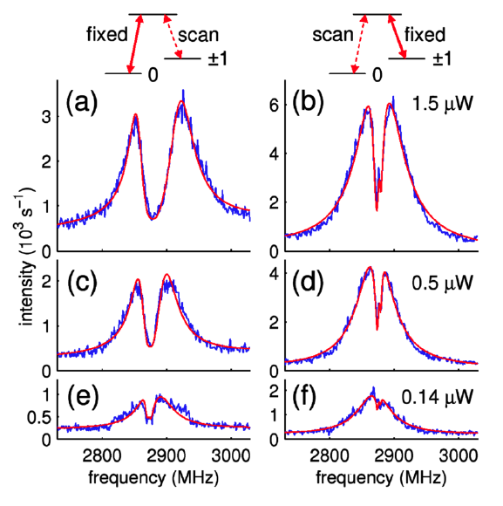
Using resonant optical transitions to access the NV spin
Optical pumping vs cycling transitions
Dispersive properties
Lambda level configurations
A₁ transition efficiently optically pumps into m_{s}= 0
Possible near zero strain
E_{x} and E_{y} can be nearly cycling transitions (low strain, low T)
100s of optical cycles
Or by tuning strain, electric, or magnetic field to induce a LAC
Coherent population trapping
Faraday rotation from a single spin
See also Togan et al. 2011 Nature
Optical Stark effect to manipulate spin energy levels
spin preparation and detection
Buckley et al. 2010 Science
Yale et al. 2013 PNAS
Raman transitions: spin manipulation
excited state
S = 1
Yale et al. 2013 PNAS
Santori et al. 2006 PRL
Optical pumping into a “dark state” on two-photon resonance
σ₊
|1 >
σ₋
ground state
S = 1
|0 >
m_{s} = ±1
Toolbox of all-optical techniques for spin preparation, measurement, and control at low temperatures
m_{s} = 0
Notes:
Finally it is possible to achieve lambda level configurations with the NV center in a variety of regimes. Let me just shift the ms = + and – 1 states apart so I can show you them more clearly. So near zero strain, I already told you that the ms = +/-1 states form lambda systems with the excited states, for example with the A2 state as shown here. By applying a field to shift and mix the excited states, you can also access lambda configurations involving the ms = 0 and 1 states. Regardless of how the lambda configuration is achieved, it provides a versatile tool for controlling the spin state. For example, by applying fields on both transitions on resonance, you can optically pump the spin into the superposition state which does not interact with the light. This so-called dark state does not fluoresce, and you can see it appear in this data when the two beams are both on resonance with the transitions. This so-called coherent population trapping can be used to prepare the spin into the dark state and detect whether or not it is in the dark state – in other words, you can perform spin preparation and measurement in an arbitrary basis, determined by the amplitude and relative phase of the laser beams. At the same time, the lambda transition allows you to use Raman transitions to manipulate the spin.
So I hope this gives you a taste of the toolbox of optical techniques available for probing the NV spin state at low temperatures.

Slide 26
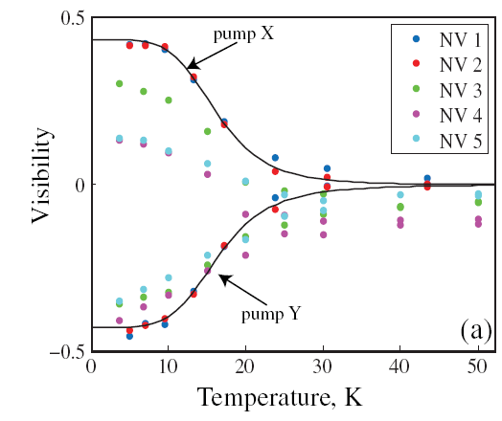
What happens as you turn up the heat?
Linewidths broaden
Electron spin resonance signal emerges in the excited state at ~100K
Fu et al. 2009 PRL
Batalov et al. 2009 PRL
Selection rules disappear
Interpretation: Fast phonon processes average over the excited state orbital degrees of freedom, leaving only the spin-spin interaction
Strain dependent
Strain independent
Fu et al. 2009 PRL
Low T
High T
Rogers et al. 2009 NJP
Notes:
Why do we need low temperatures? Well, as you turn up the heat, several things happen to the resonant optical transitions. First, the linewidths broaden, and the polarization selection rules disappear, removing the possibility for spin-selective excitation above about 10K. More mysteriously, a new ESR signal appears around 100K. The reason for these effects is that phonon processes (which turn on at these higher temperatures) induce rapid transitions between the two denerate e orbitals in the excited state. At high temperatures (room temperature), these phonon processes average out the orbital states (this is a motional averaging effect), so that the structure of the electronic excited state goes from six spin-orbit states to just three effective spin states whose energies are determined only by the spin-spin interaction. Thus at room temperature, the excited state just looks like a orbital singlet, spin triplet, independent of strain.

Slide 27
NV optical transitions at room temperature
excited state
S = 1
Nearly spin-conserving excitation
Fuchs et al. 2012 PRL
fast
Excited state lifetimes:
τ₀ ~ 12-14 ns
τ₁ ~ 7-8 ns
Robledo et al. 2011 NJP
Singlet lifetimes
τ_{singlet} ~ 200 ns (300K)
τ_{singlet} ~ 450 ns (4K)
ground state
S = 1
slow
Acosta et al. 2010 PRB(R)
m_{s} = ±1
m_{s} = 0
Fluorescence time trace (averaged over many experiments!)
Steiner et al. 2010 PRB
Fast population of singlets from m_{s} = ±1
Slow decay out of singlets
Typical SNR = 0.1 in a single shot
Optical polarization into m_{s}= 0 ~ 70-90%
Fuchs et al. 2010 Nat. Phys
Robledo et al 2011 NJP
0 500 1000
Laser duration (ns)
Spin polarization and detection at room temperature – no fancy lasers required!
Notes:
Nevertheless, even at room temperature the NV optical transitions can still be used to access its spin degree of freedom because the intersystem crossings remain spin-selective. At room temperature the ZPL is nearly completely washed out, so excitation into the phonon sideband is more effective. From the excited state,the lifetime of the ms = +/-1 excited states is much shorter than for the ms = 0 state because they have a roughly 50% probability to decay into the metastable singlet states. The singlets live for about 200 ns at room tempearture, and decay primarily into the ms = 0 state. As a result, if you look at the fluorescence of an NV center immediately after turning on nonresonant excitation, you see something different depending on the spin state. This grey trace shows the ms = +/-1 fluorescence trace, whish shows a sharp decrease owing to fast population of the singlets, and then a slow increase as the singlets decay. The red trace shows the ms = 0 fluorescence, which only slowly decays into the singlets, and the system reaches equilibrium after a few microseconds of excitation. The difference between these traces allows you to detect the spin state – though you should note that this data is highly averaged, in a typical shot you might get a signal to noise ratio of 1/10 if you were lucky. And after the system has reached equilibrium, there is a roughly 80% polarization into the ms = 0 state (though this can vary depending on the sample).
Thus it is possible to polarize and detect the NV spin at room temperature with essentially a green laser pointer.

Slide 28
A variety of optical techniques for accessing the NV spin
excited state
S = 1
All-optical control
fast
95% fidelity
|1 >
ground state
S = 1
slow
|0 >
Many photons
No photons
m_{s} = ±1
Near-resonant excitation
<10K
Non-resonant excitation
0K-600K
m_{s} = 0
Steiner et al. 2010 PRB
excited state
S = 1
Optical polarization into m_{s}= 0 ~ 70-90%
Fuchs et al. 2010 Nat. Phys
Typical SNR = 0.1 in a single shot
ground state
S = 1
0 500 1000
m_{s} = ±1
Laser duration (ns)
m_{s} = 0
Notes:
So the NV level structure provides a variety of mechanisms for accessing the spin degree of freedom with optics; while resonant excitation offers the best precision and sensitivity, there are many advantages to room temperature operation – or higher, as I think we will hear in a few days.

Slide 29
Outline
Introduction
  Context and motivation
  A brief overview of NV physics
V
The structure of the NV center
  Physical and electronic structure, optical transitions
  Spin-dependent optical processes at cryogenic and ambient temperatures
N
Spin physics with NV centers
  Hyperfine interactions
  Coherence properties
Applications and research highlights
  Quantum information science
  Metrology
Outlook
  New directions and outstanding challenges
Notes:
So now that you have some idea of how we can prepare and detect the spin state with optics, I’d like to say a bit about the properties of the NV center spin itself
51 minutes to here.

Slide 30
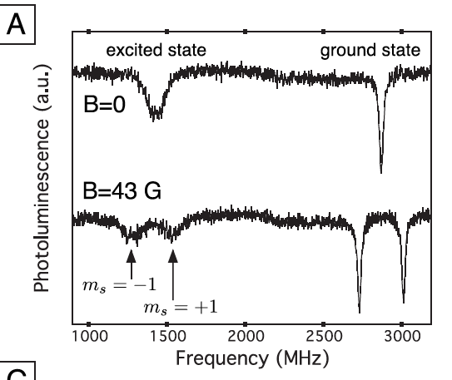
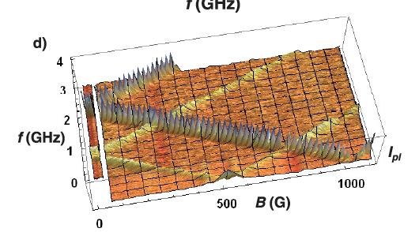
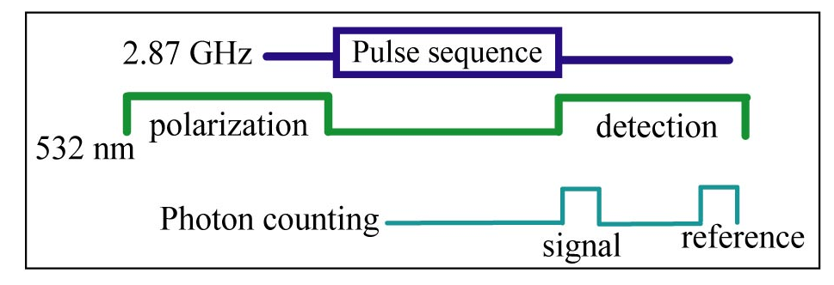
ODMR of the NV electronic spin
~ 300,000 photons/sec per defect
See Gruber et al., Science 1997
Neumann et al. 2008 NJP
532 nm
Detector
Microscope objective
fluorescence
Dichroic
MW
GSLAC
Δ_{gs} = 2.87 GHz
Δ_{es} = 1.42 GHz
excited state
1.42 GHz
ESLAC
Temperature-dependent!
-75 kHz/K
fast
Fuchs et al. 2008 PRL
g≈2
d < 20 Hz per V/cm
slow
ground state
m_{s} = ±1
Strain or electric field
2.87 GHz
m_{s} = 0
Notes:
A typical experiment for measuring magnetic resonance of the NV electronic spin at room temperature might schematically look like this. Green excitation is focused onto the diamond sample, and the red fluorescence is collected, filtered, and detected. If you do a decent job of it, you might see 300,000 photons per second from a single defect. This fluorescence is then monitored while sweeping the frequency of microwaves coupled to the sample. In such a system, what you might see in your data is this
When the microwaves are off resonance, the optical illumination pumps the spin into ms = 0, and the fluorescence is bright. When the microwaves are on resonance with either the ground or excited state spin splitting, the fluorescence drops. Recall that this zero-field splitting is set by the spin-spin interaction, but you can split the magnetic states by applying a magnetic field. Since the orbital states are effectively a singlet at room temperature, the g-factor is essentially the bare electron g-factor in both the ground and excited states. There are some further details to this spin Hamiltonian, however.
It’s worth noting that the zero field splittings are weakly temperature dependent.
Furthermore, there is some weak coupling to electric fields or strain, which can become significant – several MHz – in highly strained samples.

Slide 31
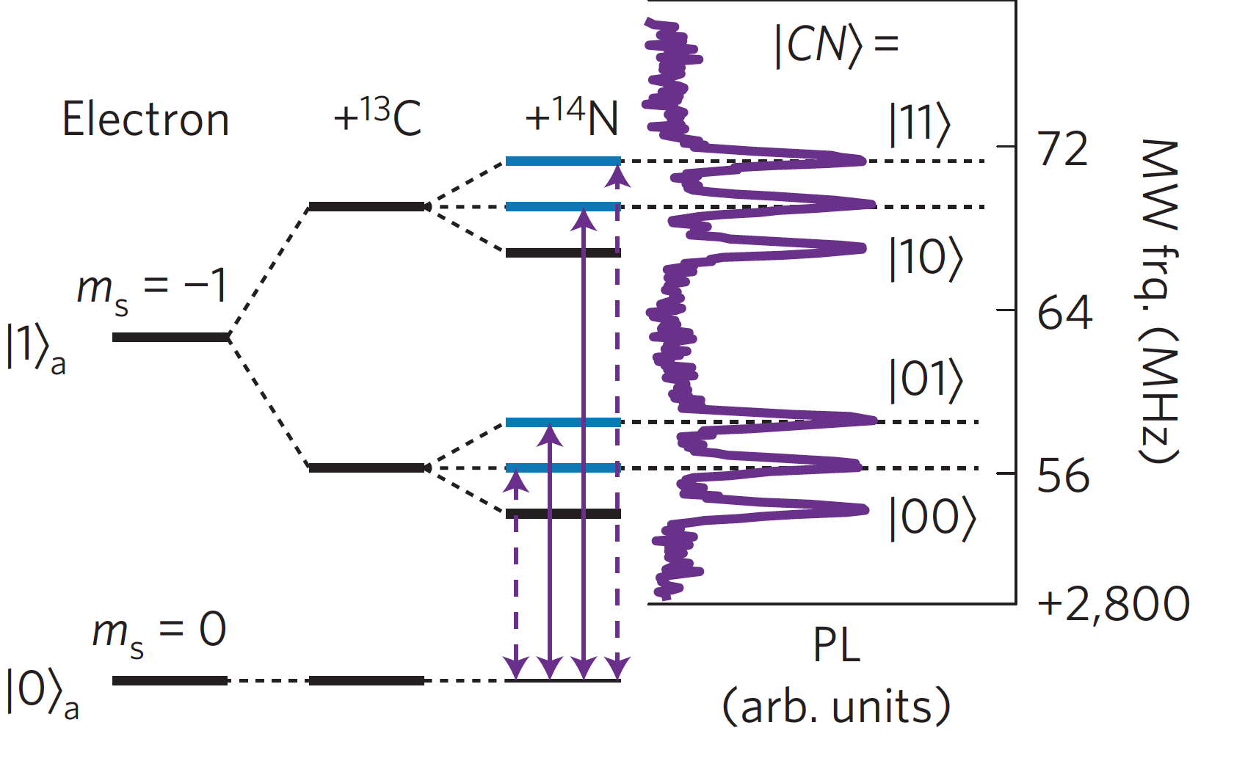
Hyperfine structure of the NV electronic spin
Neumann et al. 2008 NJP
V
Opportunity to address several nuclear spins!
See Zhao et al. 2012 Nature Nano, Kolkowitz et al. 2012 PRL, Taminiau et al. 2012 PRL
N
excited state
1.42 GHz
few kHz to 130 MHz
fast
Pfaff et al. 2013 Nat. Phys.
slow
ground state
m_{s} = ±1
Strain or electric field
2.87 GHz
m_{s} = 0
Notes:
In addition, there is hyperfine structure to consider. While diamond is mostly formed from spinless carbon-12, the host nitrogen nucleus has a spin – typically I = 1, but I = ½ is also possible – and nearby carbon-13 nuclei can also interact with the NV spin, with strengths up to 130 MHz for nearest neightbor atoms.
As a result, if you zoom in on one of these spin resonance dips in the ODMR spectrum, you might see – depending on the local configuration of carbon-13 nuclear spins – a spectrum that is split both by interactions with several nuclear spins. Indeed, there have been several recent papers demonstrating the possibility to couple to many nuclear spins, on the order of 5- 10 is conceivable.

Slide 32
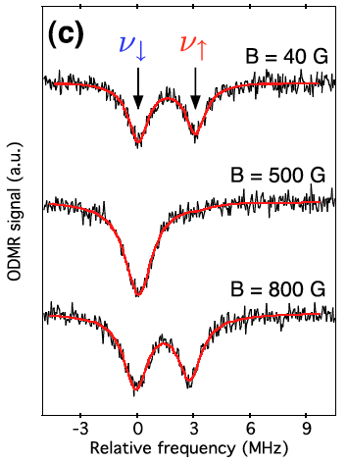
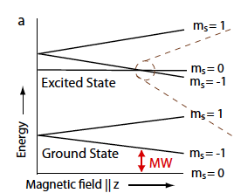
Addressing nuclear spins in diamond
Polarization
Detection
Nuclear polarization at the ESLAC:
V
Polarization
Detection
N
Jacques et al. 2009 PRL
Resonant hyperfine flip-flops
=> electron spin pumps nuclear spin
under optical excitation
=> different nuclear spin states exhibit different fluorescence
Notes:
So how can you address these nearby nuclear spins? One particularly experimentally simple technique involves tuning to the excited state level anticrossing, where the energy to flip the electronic spin in the excited state vanishes. Flip-flops between electronic and nuclear spins thus become resonant, and the electronic spin can efficiently transfer its polarization to nearby nuclei. Here this data shows how one of the hyperfine lines for an I = ½ nucleus disappears when you tune to the ESLAC. For similar reasons, the nuclear spin state also directly affects the fluoresence at the ESLAC

Slide 33
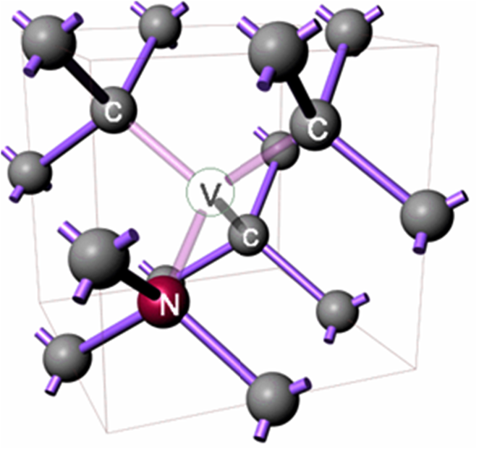
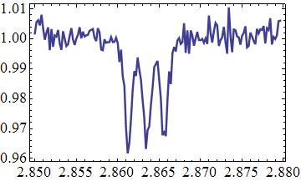
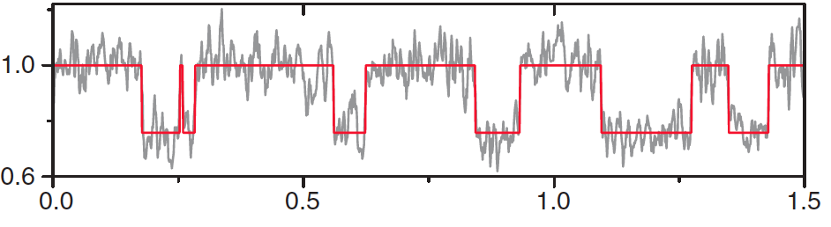
Addressing nuclear spins in diamond
V
Polarization
Detection
¹⁴N hyperfine lines
N
Fluorescence
Using resonant readout: 98.5% readout fidelity for nuclear spins (Hanson)
Up to 99.6% readout fidelity for nuclear spins (from Wrachtrup group)
2.86
2.87
Microwave frequency (GHz)
Similar techniques work with resonant excitation at low temperature
For some lattice sites (and B fields), electron spin readout does not flip the nuclear spin
Rotates electronic spin conditional on the nuclear spin state – a CNOT gate
Maybe add something here on what has been done with nuclear spins recently!??
Repetitive, non-destructive detection of a single nuclear spin:
Single shot detection and preparation by measurement
Neumann et al 2010 Science
Notes:
More generally, the spectrally resolved hyperfine lines allow you to perform gates between the electronic and nuclear spins. Here are the 14N hyperfine lines, and if I drive a pi pulse on one of these transitions – for example the nuclear spin down transition – then I’ve flipped the electron spin dependent on the nuclear spin state – i.e. a CNOT gate. This allows you to write the nuclear spin state onto the electron spin, and then measure the electron spin to determine what the nuclear spin state was.
Interestingly, for some nuclei and magnetic field configurations, this process does not flip the nuclear spin (though of course it certainly projects it), so it forms a nondestructive probe of the nuclear spin state, and you can repeat it thousands of times to distinguish the nuclear spin state. This data shows the change in fluorescence during repeated nondestructive detection of the nuclear spin, and I think the x-axis should be time in seconds, illustrating quantum jumps of the nuclear spin state. This type of detection allows you to prepare and detect the nuclear spin state with high fidelity even at room temperature.

Slide 34
NV electronic spin coherence properties
T₂* - as measured by free induction decay
Determined by interactions with the environment: highly sample-dependent!
T₂ – as measured by Hahn echo or decoupling sequences
T₁ – longitudinal relaxation time
Surface states
Add a picture from Amir’s recent paper of the surface spins!
Paramagnetic impurites (N)
phonons
¹³C nuclear spins
Notes:
One of the major attractions of the NV center is that this level of spin control is also accompanied by highly coherent evolution. The coherence properties of individual spins are typically characterized by several timescales, T2*, T2, and T1. However, I can’t give you a number for these three quantities -- they are typically highly dependent on the sample, and also, sometimes, on the temperature.
Physically, there are several elements of the environment which influence the coherence of the NV electronic spin. Spin-orbit interactions lead to dephasing and relaxation from phonons in the diamond lattice – though this is weak owing to the small spin orbit effect in diamond. Nuclear spins – typically 13C, which is present in 1.1% isotopic purity in natural diamond – nuclear spins typically limit the dephasing time in high purity samples. In samples with a large concentration of paramagnetic impurities or proximal surface states, coherence times can be much shorter.
So I’ll try to focus on the best possible properties, but please do keep in mind that I’m giving you the record numbers, not the typical values, which depend strongly on sample quality.

Slide 35
NV electronic spin coherence properties
T₂* - as measured by free induction decay
Determined by interactions with the environment: highly sample-dependent!
T₂ – as measured by Hahn echo or decoupling sequences
T₁ – longitudinal relaxation time
Convert phase to population, measure average phase accumulation
Create spin superposition state
Allow phase to accumulate
(quasi-static)
Notes:
The dephasing time is typically measured by free induction decay. After polarizing the spin, a pi/2 pulse creates a spin superposition, which is allowed to accumulate phase. To get a rough idea, you could consider a simple classical magnetic noise, where the phase rotates as a function of the random value of the noise. A second pi/2 pulse converts the phase to population, which is then measured. As the experiment is repeated thousands of times, you average over all the possible values of the noise, including whatever DC components exist, yielding a quantity which can oscillate and decay as a function of tau.

Slide 36
NV electronic spin coherence properties
T₂* - as measured by free induction decay
Determined by interactions with the environment: highly sample-dependent!
T₂ – as measured by Hahn echo or decoupling sequences
T₁ – longitudinal relaxation time
Ranges from 100s ns to nearly a millisecond!
Isotopically purified sample (0.01% ¹³C)
T₂* = 0.5 ± 0.1 ms
Maurer et al. 2012 Science
Beating from different ¹³C hyperfine transitions
Notes:
The decay of the free induction (or T2*) can vary tremendously, from around 100ns in HTHP samples to nearly a millisecond in isotopically purified samples, where a T2* of 500 microseconds has been measured, limited likely by residual nuclear spins in the sample.
However it is worth noting that this experiment measures dephasing as averaged over many hours of data taking, and includes any fluctuations in the environment that occur on that timescale.

Slide 37
NV electronic spin coherence properties
T₂* - as measured by free induction decay
Determined by interactions with the environment: highly sample-dependent!
T₂ – as measured by Hahn echo or decoupling sequences
T₁ – longitudinal relaxation time
τ
τ
Decouples noise slower than τ
Convert total phase to population, measure average phase accumulation
Create spin super-position state
Allow phase to accumulate
(quasi-static)
Unwind phase
(quasi-static)
(quasi-static)
Notes:
T2, as measured by the Hahn echo experiment eliminates the sensitivity to quasistatic environmental noise by flipping the spin halfway through, so that phase accumulation in the second free precession period cancels phase accumulation in the first free precession period when the einvironment doesn’t change. As a result, this measurement decouples environmental noise slower than tau, the time between spin flips.
And you would expect that T2 should greatly exceed T2* when the environment is slowly varying – such as for a nuclear spin bath.

Slide 38
NV electronic spin coherence properties
T₂* - as measured by free induction decay
Determined by interactions with the environment: highly sample-dependent!
T₂ – as measured by Hahn echo or decoupling sequences
T₁ – longitudinal relaxation time
τ
τ
Decouples noise slower than τ
Ultimately limited by spin-lattice interactions
N
Environment has opposite effect during first and second free precession periods
Isotopically purified sample (0.01% ¹³C)
τ
τ
τ
De Lange et al. 2010 Science.
See also:
Ryan et al. 2010 PRL,
Naydenov 2011 PRB
T₂
=> T₂ >> T₂* when the environment is slowly-varying
T₂ up to ~few ms at 300K
580 ms at 77K
Bar-Gill et al.
2013 Nat. Comm.
Notes:
This approach can cancel even higher frequency components of noise by adding repeated spin flips, so called CPMG or dynamical decoupling sequences, which extend the spin coherence out to longer and longer times as more and more spin flips are added. Eventually, however, this procedure hits a limit set by the fast phonon bath, which can only be ameliorated by cooling the sample.
To give you a sense of the achievable T2 times, they reach few ms at 300K and have recently been measured to be longer than half a second at liquid nitrogen temperatures.

Slide 39
NV electronic spin coherence properties
T₂* - as measured by free induction decay
Determined by interactions with the environment: highly sample-dependent!
T₂ – as measured by Hahn echo or decoupling sequences
T₁ – longitudinal relaxation time
Ultimate limit to the coherence time (T₂ ≤ 2T₁)
6 ms (300K)
Mechanisms:
Coupling to local and lattice phonons (two-phonon processes)
Cross-relaxation with paramagnetic impurities
S2: HPHT, high [N], [NV]
S8: HPHT, high [N], low [NV]
S3: CVD, low [N], very low [NV]
Jarmola et al. 2012 PRL
200 s (10K)
B = 25 G
Notes:
As this last slide hinted, ultimately the coherence properties of the spin are limited by relaxation, which is also sample and temperature dependent. NV relaxation occurs primarily through spin-phonon coupling at moderate tempeartures, and is ultimately limited by crossrelaxation with other paramagnetic impurities at low temperature. These timescales range from 6ms at room temperature down to several minutes at low temperatures, hinting at the long coherence times that could be attained at liquid helium temperatures.

Slide 40
Nuclear spin coherence properties
T₂* - as measured by free induction decay
Expect ~1000 x better than electronic spin
T₂ – as measured by Hahn echo or decoupling sequences
T₁ – longitudinal relaxation time
Potential issue: NV electronic spin relaxation can dephase nearby nuclei
Continuous illumination
=> electronic spin polarization
=> motional averaging
Isotopically purified sample 0.01% ¹³C
Maurer et al. 2012 Science
T₂* = 0.5 seconds at room temperature
Cryogenic relaxation times can exceed a day…
Notes:
Already, there are some remarkable results for the electronic spin coherence properties, and simply based on its gyromagnetic ratio you might expect that a nuclear spin in diamond should have roughly 1000x better coherence properties. However, proximity to an NV center creates another avenue for dephasing via electronic spin relaxation.
Interestingly, optical excitation can help. By continuously polarizing the NV electronic spin – and in the process motionally averaging over its electronic configurations, you can extend the coherence of a nearby nuclear spin (near enough to be prepared and measured via the NV center), you can extend the coherence time of the nuclear spin beyond the electron spin relaxation time. These experiments from the Harvard group demonstrated a T2 time in excess of a second at room temperature. While no one has done the experiment yet, cryogenic nuclear relaxation times can exceed a day for bulk diamond, so I think there is the potentially for extraordinarily long-lived quantum memory with nuclear spins in diamond.

Slide 41
Outline
Introduction
  Context and motivation
  A brief overview of NV physics
V
The structure of the NV center
  Physical and electronic structure, optical transitions
  Spin-dependent optical processes at cryogenic and ambient temperatures
N
Spin physics with NV centers
  Hyperfine interactions
  Coherence properties
Applications and research highlights
  Quantum information science
  Metrology
Outlook
  New directions and outstanding challenges
Notes:
And this really leads right into one of the major research areas for applications of the NV center, quantum information science

Slide 42

NV diamond and quantum information
Each NV center:
Several optically addressable, highly-coherent spins
=> a “quantum register”
V
Single- and two- qubit gates on ns (e) to μs (n) timescales
Diamond
Inside
N
Benchmarks:
3-bit quantum error correction (2-3 nuclear spins)
Violation of Bell’s inequalities (> 4 s.d.) with two nuclear spins
High-fidelity gates
Single-qubit: 99.993%
Two-qubit: 99.2%
Waldherr et al. Nature 506, 204 (2014)
Taminiau et al. Nature Nano 9, 171 (2014)
Rong et al. 2015 ArXiv
Pfaff et al. 2013 Nat. Phys.
Challenges:
V
Gate and Readout fidelities almost high enough
Limit to the number of spins that can be coherently addressed
How to engineer interactions between different quantum registers?
N
Notes:
One vision for using the NV center for quantum information involves thinking of each defect as a kind of quantum register, comprising optically addressable and highly coherent electronic and nuclear spins.
Within this type of quantum register, the community has developed essentially full control, combining optical preparation and detection with fast magnetic resonance gates. Some of the benchmark demonstrations include violation of Bells inequalities using two nuclear spins near a single NV center and demonstration of elementary quantum algorithms.
While the gate and readout fidelities are still only in the roughly 95% range, in my opinion the bigger challenge to using NV centers for quantum information lies in the limitation of the number of spins that can be addressed in this manner, and in particular how to engineer interactions between different defect centers

Slide 43
Magnetic dipolar interactions
Requires closely-spaced defects
V
20 kHz DQ coupling at 25 nm
Dolde et al. 2013 Nat. Phys.
N
Separation (nm)
Sufficient to generate entanglement between different NV electronic spins (67% fidelity) , and transfer it to nuclear spins
Dolde et al. 2013 Nat. Phys.
V
N
Notes:
One way is to use magnetic interactions between the electronic spins. However, to have the electronic interactions exceed dephasing rates requires that the NV centers be very close to one another, a couple dozen nanometers or so. Nevertheless, using apertured implanation techniques it is possible to create such defects, and recently the Stuttgart group has been able to use such interactions to observe entangled states of two NV electronic spins

Slide 44
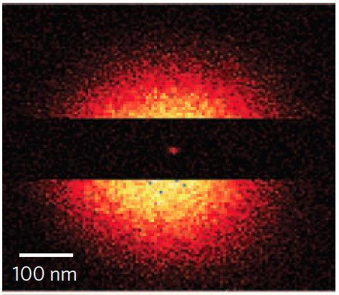
Closely-spaced defects
Requires closely-spaced defects
Dipolar interactions (~20 kHz) between electronic spins
20 kHz DQ coupling at 25 nm
25 nm
Dolde et al. 2013 Nat. Phys.
Separation (nm)
See Bermudez et al. 2011 PRL
Sufficient to generate entanglement between different NV electronic spins (67% fidelity) , and transfer it to nuclear spins
Quantum bits encoded in nuclear spins
e
Super-resolution imaging
e.g. STED
Dolde et al. 2013 Nat. Phys.
Excited state
S = 1
Excite
Deplete
2.4 nm resolution has been achieved
Detect
Diffraction limit
Wildanger et al. 2012 Adv. Mat.
Rittweger et al. 2009 Nat. Photonics
Similar techniques for nanoscale spin addressing
Ground state
S = 1
Maurer et al. 2010 Nat. Physics
Only the central defect fluoresces
Notes:
This type of system might someday be scaled into arrays of defects where nuclear spins encode quantum information, and dipolar interactions between electronic spins mediate nuclear spin gates, though at the moment such interactions remain at the proposal level.
Such efforts might be aided by advances in imaging NV centers below the diffraction limit – which is also a highly interesting result in its own right. There are many ways to do this, but the one that has achieved the best resolution is based on stimulated emission depletion, where a gaussian green excitation beam is overlapped with a donut shaped depletion beam that stimulates fast transitions from the excited state to the ground state. In this geometry, only a defect in the donut hole can spontaneously fluoresce, making it possible to create images with nanometric resolution. This picture overlaps a confocal spot – the large, diffraction limited image – with a STED image. Can you even see the tiny dot in the middle? Recently resolution as low as 2.4 nm has been achieved, and similar techniques have been used for nanoscale spin addressing.

Slide 45
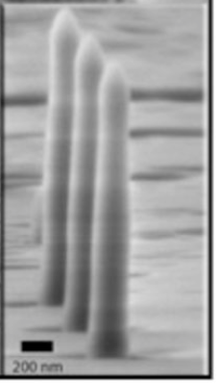
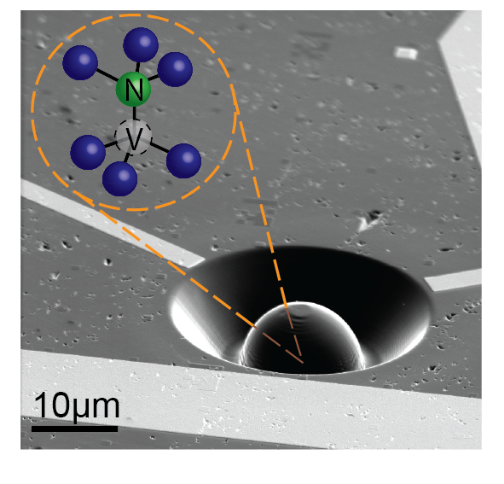
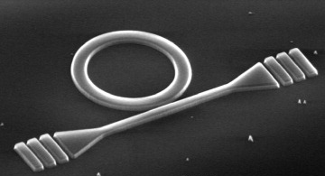
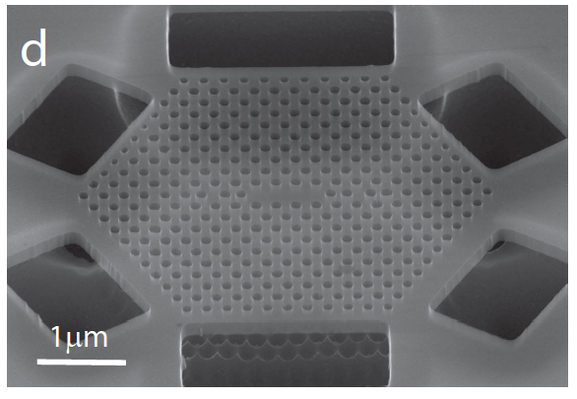
Optically mediated interactions
V
Good selection rules and narrow optical transitions at cryogenic temperatures
V
Quantum interference
(indistinguishable photons)
Bernien et al 2012 PRL
N
Spin-photon entanglement
Togan et al. 2010
N
Integrated optical devices:
Coincidence detection
→ leaves spins entangled
excited state
S = 1
Bernien et al. Nature 2013
Harvard
2010
Challenges:
Frequency stability
ZPL collection efficiency
Optical cavities for Purcell enhancement of ZPL:
σ₊
σ₋
Photonic crystal cavity
2-ZPL photon success rates very low
ground state
S = 1
m_{s} = ±1
Faraon et al. NJP 2013
HP labs 2012
m_{s} = 0
Notes:
An alternate approach to engineering interactions between NV centers takes advantage of their good selection rules and coherent optical transitions at low temperatures, using coherent photons to mediate interactions at a distance. One mechanism to do this involves entangling the spin of the NV center with, for example, the polarization of an out going photon. This was achieved a few years ago by exciting the NV center into the A2 state, and simply letting it decay according to its polarization selection rules. If you can create this type of spin-photon polarization for two defects, and get the photons to interfere coherently on a beamsplitter (which requires that they be indistinguishable in all but the degree of freedom entangled with the NV defect) then coincidence detection of the photons can project the spins onto an entangled state – and I hope you’ll hear a lot more about this recent experiment later this week.
This is a challenging experiment, but one of the central challenges is attaining sufficient ZPL collection efficiency. Only the 3% of photons emitted on the ZPL can behave coherently, and only a fraction of those are typically collected, yielding very low success rates for two-photon experiments. Such considerations have spurred development of a variety of integrated optical devices, including micropillars and solid immersion lenses for increasing collection efficiency and many types of optical cavities for enhancing emission into the ZPL.
So on the quantum information front, there’s a great deal of interest in figuring out how to take advantage of the long coherence times that the NV center offers as a qubit.

Slide 46
Good qubits can be good sensors
Long-lived coherence enables longer detection times for metrology
Picks up an extra phase
m_{s} = +1
m_{s} = - 1
m_{s} = 0
Field sensitivity scales linearly with time
…as long as the qubit remains coherent
B_{ext}
How sensitive?
During free precession time τ, phase accumulation
gives a minimal B field sensitivity
Wish list:
Long coherence times
Excellent spin control and detection
High density
which decreases as the square root of the number T/τ of measurements
→ spatial resolution
Notes:
But if you have a good qubit, quite often you also have a good sensor.
Why is this? Well, suppose that you can create a superposition state of your qubit – in this case the electronic spin of the NV center. This spin is sensitive to the external magnetic field, and will pick up a phase as a function of time that is proportional to the external magnetic field. The longer you can maintain that superposition, the smaller the magnetic field you can detect. So quite frequently one finds that the best qubits also make excellent sensors.
How sensitive is the NV center to magnetic fields?
We can estimate this.
During a free precession time tau, the NV will accumulate the following phase; setting the phase equal to one gives a rough estimate for the minimum field sensitivity per measurement. If you perform several measurements in total time T, of course, you can measure smaller fields. Accounting for this averaging effect, sensitivity is typically expressed in units of magnetic field per root Hertz, and from this sensitvity (eta), you can see what is desired in a sensitive magnetometer: long dephasing times, good spin control and detection – this parameter C accouns for imperfect spin initialization and measurement – and a large number of spins per unit volume for good spatial resolution.

Slide 47
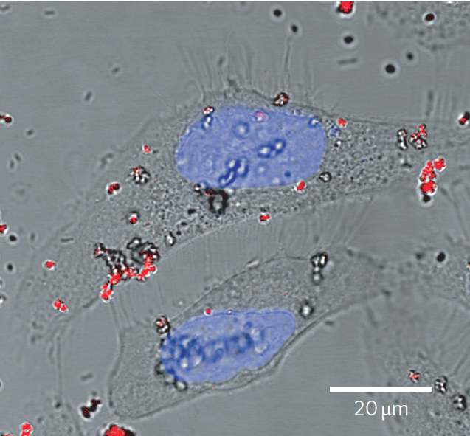
DC magnetometry
How sensitive?
DC magnetometry is limited by dephasing T₂*
~ μT/√Hz per NV under good conditions
Sensitivity: 6 μT/√Hz
Maletinsky et al. 2012 Nature Nano
See also Rondin et al. 2012 APL, Balasubramanian et al. 2008 Nature
Why is this interesting?
Spatial resolution ~ 10s nm
Acosta et al. 2009 PRB
Possibility for dense ensembles
4.6 nT/√Hz (10 μm ensemble)
Shin et al. 2012 JAP
Nano-diamond uptake in HeLa cell
Large temperature and pressure range
Not chemically reactive
Nontoxic
McGuinness 2011
Nature Nano
Can you somehow access the intrinsic coherence time (T₂) for even more sensitive measurements?
Notes:
So how sensitive is an NV center? Well, using optimistic values, you might hope for a microtesla per root Hz under good conditions – that means you could measure a microtesla field if you averaged for a second. That doesn’t sound too impressive. Why is this interesting? Well, the NV center has a very small spatial extent, and it has been possible to achieve a spatial resolution of a couple dozen nanometers by mounting an NV into a nanopillar on the tip of an AFM. Here, you can see a magnetic image of magnetic domains in a hard drive in a system from work in the Yacoby group, but there have been similar efforts also under way in Stuttgart, Paris, Zurich, and other groups around the world. You can also achieve dense ensembles of NV centers to increase the magnetic field sensitivity, and the diamond matrix is quite robust and also nontoxic.
However, it feels like this level of sensitivity is not taking full advantage of the NV coherence, since it is limited by T2*, and it is natural to consider whether higher precision sensors could take advantage of the full coherence time T2

Slide 48
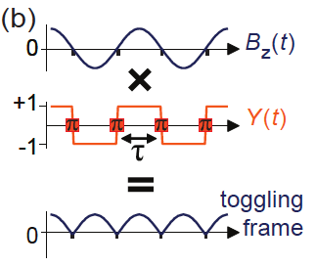
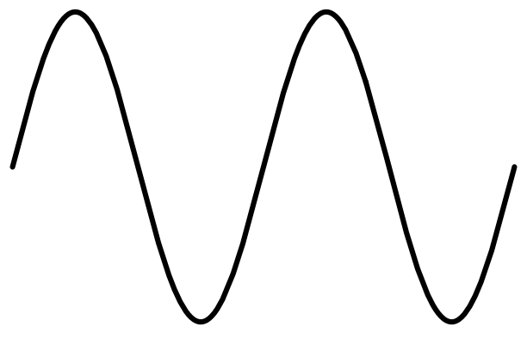
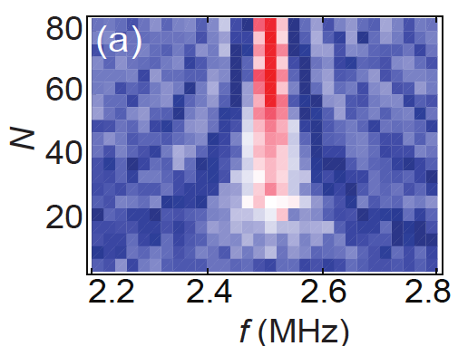
AC magnetometry
What kinds of B fields would the signal from a decoupling sequence be sensitive to?
Intuitive picture:
Recently used to image NMR signals with ~10 nm resolution
DeVience et al. Nat Nano. 2015 (Harvard)
Haberle et al. Nat. Nano. 2015 (Stuttgart)
Rugar et al. Nat. Nano. 2015 (IBM & Chicago)
Insensitive to DC (that’s the point!)
B_{z}(t)
τ
Accumulated phases add
T₂
Most sensitive to components of B_{z}(t) oscillating at ~1/2τ
Insensitive to quasi-static noise in the environment
For a given frequency 1/ τ, can measure out to the full coherence time T₂ using dynamical decoupling (CPMG)
De Lange et al. 2010 PRL
Notes:
The answer of course is yes, you would need to use a spin-echo or decoupling sequence instead of a Ramsey sequence.
But what kind of B fields would the signal from a decoupling sequence be sensitive to?
Because the decoupling sequence flips the spin regularly, it is insensitive to DC fields – that’s kind of the whole point of the spin echo! But, if you have a magnetic field oscillating at the same frequency as the spin flips, the accumulated phases add, yielding sensitivity to a specific AC frequency while decoupling quasistatic noise in the environment. Since T2 can be several orders of magnitude larger than T2*, this greatly enhances the sensitivity, and this type of technique was recently used to detect the tiny oscillating magnetic field originating from 100 polarized protons in a 5nm sample volume.

Slide 49
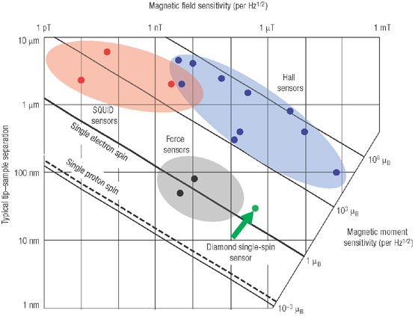
AC magnetometry
How sensitive?
~ few nT/√Hz per NV under good conditions
18 nT/√Hz (measured, single NV, MHz frequencies)
Grinolds et al. 2013 Nat. Phys.
Degen 2008 Nature Nano
A unique combination of spatial resolution and sensitivity
Notes:
So AC magnetometry can really be quite sensitive, ideally at the level of a few nT per root Hz. To give you an idea of where this fits in, I’ve stolen this image from one of Christian Degen’s articles, which illustrates the regions of magnetic sensitivity and spatial scale accessible with current detectors. This graph is a few years old, and recent results have surpassed the single electron spin detection limit and are marching steadily toward detection of a single external proton. So I think the NV center offers a unique combination of spatial resolution and sensitivity for magnetometry.

Slide 50
Outline
Introduction
  Context and motivation
  A brief overview of NV physics
V
The structure of the NV center
  Physical and electronic structure, optical transitions
  Spin-dependent optical processes at cryogenic and ambient temperatures
N
Spin physics with NV centers
  Hyperfine interactions
  Coherence properties
Applications and research highlights
  Quantum information science
  Metrology
Outlook
  New directions and outstanding challenges
Notes:
Well I’m basically out of time, so let me just briefly mention all the things that I didn’t get to talk about!

Slide 51
Outlook
The NV center: an atomic-scale defect with optical access to highly coherent electronic and nuclear spin states
Potential for applications in quantum information and magnetometry
There’s a lot I didn’t get to!
New types of sensors
    Electric field, frequency, acceleration, themometry
  New approaches to working with NVs
    Mechanical oscillators or phonons to mediate interactions
    Coupling NV ensembles to superconducting devices
Kubo et al 2011 PRL
Rabl et al. 2010 Nat. Phys.
Integration with electronic structures (e.g. p-i-n junctions)
And much more…
Notes:
And there are many. I only discussed magnetometry, but the NV center can also be used to probe electric fields, measure frequency or acceleration or even temperature.
There are also a lot of new approaches to working with NV centers, integrating them with high quality mechanical oscillators or coupling them to superconducting devices, and much more

Slide 52
Outlook
The NV center: an atomic-scale defect with optical access to highly coherent electronic and nuclear spin states
Potential for applications in quantum information and magnetometry
And there’s a lot we haven’t done yet
Scalable mechanism for coupling different NV centers
Integration of frequency-stable NVs with high cooperativity optical resonators
Deterministically creating stable NVs with few-nm accuracy
Outstanding goals in metrology
Mapping individual external nuclear spins
Imaging neural activity
fT/√Hz ensemble sensitivity
And much more…
An exciting time for NV physics
Notes:
But there is also a lot that we haven’t done yet. Some of the outstanding challenges I see for quantum information science and metrology are still out there, along with the things I’ve never dreamed of. So I think it’s a pretty exciting time for NV physics.
Thank you.

